Slide 1
Solid State Reactions
Phase Diagrams and Mixing
Prof Ken Durose,
Univ of Liverpool
Text book for this lecture:
Callister – Materials Science and Engineering

Slide 2
Learning objectives
1.Solid state reactions
Recap: how Gibbs Free Energy can be used to predict reactions
3 Mixing
Understand the thermodynamic basis of mixing
Understand the origin of the miscibility gap
Be able to use the phase diagram to predict miscibility phenomena
2 Phase diagrams
Be able to read a phase diagram
Be able to identify the phases present at a given point
Be able to calculate how much of those phases there are
Be able to predict the microstructures from the phase diagram
There will be worked
examples on this bit
for you to practice ….

Slide 3


1. Prediction of reactions
e.g. solar cell contact – metal M to semiconductor AB
M
stable
M
AB
AB
or
unstable
M
MB + A
AB
M + AB → MB + A
Will it happen at equilibrium?
k_{eqm} = [MB]*[A] /[M]*[AB]
If k_{eqm} is large, the reaction goes from l to r
Find the Gibb’s free energy for the reaction.
If ∆G is large and negative, k_{eqm} is large and the reaction goes from l to r

Slide 4
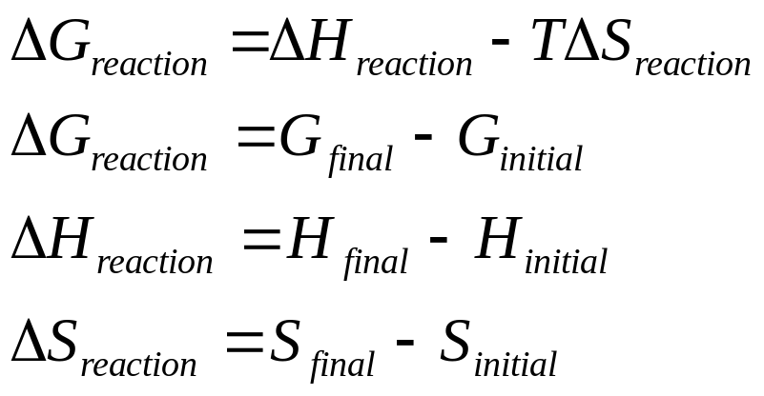
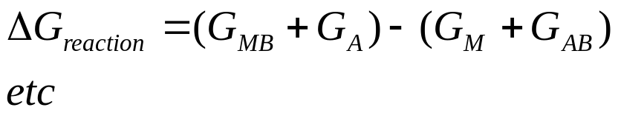
1. Prediction of reactions
M + AB → MB + A
If ∆G is large and negative, k_{eqm} is large and the reaction goes from l to r
In this case the contact would be unstable to reaction to the solar cell
materials. The contact could become non-Ohmic, the series resistance
could increase, and the performance could become unstable.

Slide 5
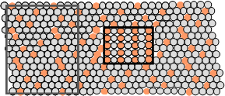
2. Equilibrium phase diagrams
ISSUES TO ADDRESS...
• When we combine two elements...
what equilibrium state do we get?
• In particular, if we specify...
--a composition (e.g., wt% Cu - wt% Ni), and
--a temperature (T )
then...
How many phases do we get?
What is the composition of each phase?
How much of each phase do we get?
Phase A
Phase B
Nickel atom
Copper atom

Slide 6
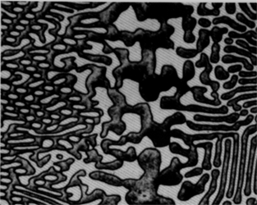
Components and Phases
• Components:
The elements or compounds which are present in the mixture
(e.g., Al and Cu)
• Phases:
The physically and chemically distinct material regions
that result (e.g., α and β).
Aluminum-
Copper
Alloy
β
(lighter
phase)
α
(darker
phase)
Adapted from chapter-opening photograph, Chapter 9, Callister 3e.

Slide 7
Phase Equilibria
Simple solution system (e.g., Ni-Cu solution)
 | Crystal Structure | electroneg | r (nm)
Ni | FCC | 1.9 | 0.1246
Cu | FCC | 1.8 | 0.1278
Both have the same crystal structure (FCC) and have
similar electronegativities and atomic radii (W. Hume –
Rothery rules) suggesting high mutual solubility.
Ni and Cu are totally miscible in all proportions.

Slide 8
Phase Diagrams
• Indicate phases as function of T, C_{o}, and P.
• For this course:
-binary systems: just 2 components.
-independent variables: T and C_{o} (P = 1 atm is almost always used).
T(°C)
• Phase
Diagram
for Cu-Ni
system
1600
• 2 phases:
L
(liquid)
1500
L (liquid)
α
(FCC solid solution)
1400
• 3 phase fields:
liquidus
α
L
1300
+
L +
α
L
solidus
α
1200
α
Adapted from Fig. 9.3(a), Callister 7e.
(Fig. 9.3(a) is adapted from Phase Diagrams of Binary Nickel Alloys, P. Nash (Ed.), ASM International, Materials Park, OH (1991).
(FCC solid
1100
solution)
1000
wt% Ni
0
20
40
60
80
100

Slide 9
Phase Diagrams: number and types of phases
• Rule 1: If we know T and C_{o}, then we know:
--the number and types of phases present.
T(°C)
• Examples:
1600
A(1100°C, 60):
L (liquid)
1 phase:
α
1500
Cu-Ni
phase
diagram
liquidus
B
(1250°C, 35):
1400
(1250°C,35)
α
solidus
2 phases: L +
α
1300
+
α
B
L
(FCC solid
1200
solution)
Adapted from Fig. 9.3(a), Callister 7e.
(Fig. 9.3(a) is adapted from Phase Diagrams of Binary Nickel Alloys, P. Nash (Ed.), ASM International, Materials Park, OH, 1991).
1100
A(1100°C,60)
1000
wt% Ni
0
20
40
60
80
100

Slide 10
Phase Diagrams: composition of phases
• Rule 2: If we know T and C_{o}, then we know:
--the composition of each phase.
Cu-Ni system
• Examples:
T(°C)
C
= 35 wt% Ni
T
A
o
A
tie line
L (liquid)
liquidus
At T
A
= 1320°C:
1300
α
L
+
Only Liquid (L)
B
C
L
= C
o
( = 35 wt% Ni)
T
B
solidus
α
α
At T
D
= 1190°C:
L
+
1200
D
(solid)
Only Solid (
α
)
T
D
C
α
= C
o
( = 35 wt% Ni
)
20
30
32
35
40
4
3
50
At T
B
= 1250°C:
C
L
C
o
C
α
wt% Ni
Both
α
and L
Adapted from Fig. 9.3(b), Callister 7e.
(Fig. 9.3(b) is adapted from Phase Diagrams
of Binary Nickel Alloys, P. Nash (Ed.), ASM International, Materials Park, OH, 1991.)
C
L
= C
liquidus
( = 32 wt% Ni here)
C
α
= C
solidus
( = 43 wt% Ni here)

Slide 11
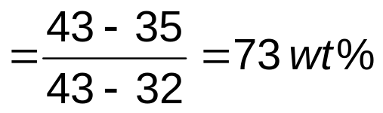
Phase Diagrams: weight fractions of phases – ‘lever rule’
• Rule 3: If we know T and C_{o}, then we know:
--the amount of each phase (given in wt%).
Cu-Ni system
• Examples:
T(°C)
C
o
= 35 wt% Ni
T
A
A
tie line
At T
A
: Only Liquid (L)
L (liquid)
liquidus
1300
α
W
= 100 wt%, W
α
= 0
L
+
L
B
At T
D
:
Only Solid (
α
)
T
B
R
S
solidus
W
= 0, W
= 100 wt%
α
α
L
α
L
+
1200
D
(solid)
At T
B
:
Both
α
and L
T
D
=
S
20
3
0
32
35
4
0
4
3
5
0
W_{L}
R
+
S
C
L
C
o
C
α
wt% Ni
R
Adapted from Fig. 9.3(b), Callister 7e.
(Fig. 9.3(b) is adapted from Phase Diagrams of Binary Nickel Alloys, P. Nash (Ed.), ASM International, Materials Park, OH, 1991.)
W_{α}
=
= 27 wt%
R
+
S

Slide 12
e.g.: Cooling in a Cu-Ni Binary
• Phase diagram:
Cu-Ni system.
T(°C)
L: 35wt%Ni
L (liquid)
Cu-Ni
system
• System is:
--binary
i.e., 2 components:
Cu and Ni.
--isomorphous
i.e., complete
solubility of one
component in
another; α phase
field extends from
0 to 100 wt% Ni.
α
130
0
A
+
L: 35 wt% Ni
L
α: 46 wt% Ni
B
35
C
46
32
43
D
L: 32 wt% Ni
24
36
α
α
:
43 wt% Ni
120
0
L
+
E
L: 24 wt% Ni
α
α
:
36 wt% Ni
(solid)
• Consider
C_{o} = 35 wt%Ni.
110
0
20
3
0
35
4
0
5
0
Adapted from Fig. 9.4, Callister 7e.
C
o
wt% Ni

Slide 13
Equilibrium cooling
The compositions that freeze are a function of the temperature
At equilibrium, the ‘first to freeze’ composition must adjust on further cooling by solid state diffusion
We now examine diffusion processes – how fast does diffusion happen in the solid state?

Slide 14
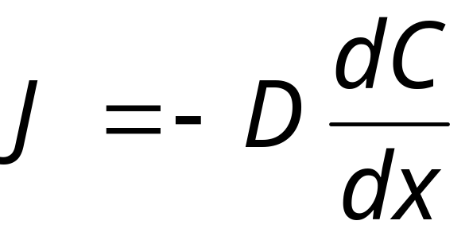
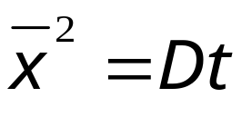
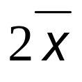
Diffusion
t = 0
Fick’s law – for steady state diffusion
J = flux – amount of material per unit area per unit time
C = conc
t = 0
C_{o}
C
x
C
3C_{o}/4
t = t
C_{o}/2
C_{o}/4
x

Slide 15
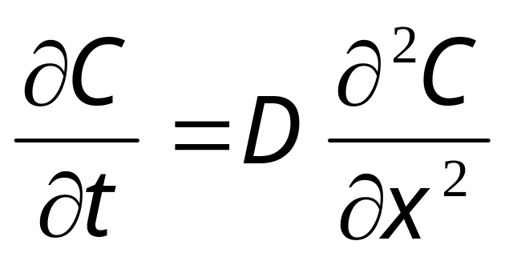
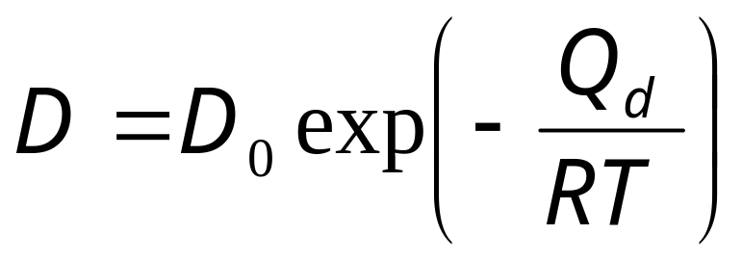
Diffusion cont….
Diffusion coefficient D (cm²s⁻¹⁾
Non-steady state diffusion
Fick’s second law
Diffusion is thermally activated

Slide 16
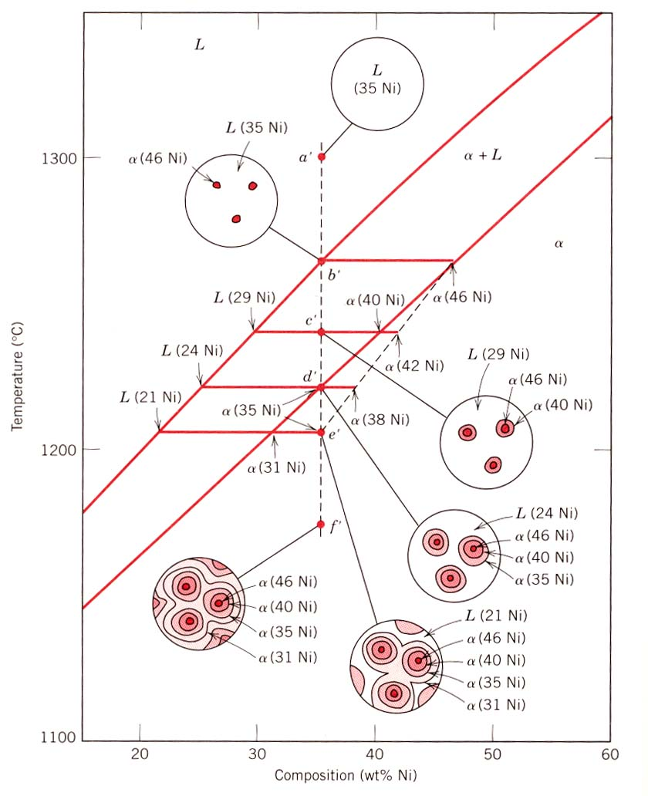
Non – equilibrium cooling
L
α + L
α

Slide 17
Cored vs Equilibrium Phases
• C_{α} changes as we solidify.
• Cu-Ni case:
First α to solidify has C_{α} = 46 wt% Ni.
Last α to solidify has C_{α} = 35 wt% Ni.
• Fast rate of cooling:
Cored structure
• Slow rate of cooling:
Equilibrium structure
α
Uniform C
α
:
First
to solidify:
46 wt% Ni
35 wt% Ni
Last
α
to solidify:
< 35 wt% Ni

Slide 18
Mechanical Properties: Cu-Ni System
• Effect of solid solution strengthening on:
--Tensile strength (TS)
--Ductility (%EL,%AR)
60
%EL
for pure Cu
400
50
%EL
for
TS for
pure Ni
Elongation (%EL)
pure Ni
40
Tensile Strength (MPa)
300
TS for pure Cu
30
200
20
0
20
40
60
80
100
0
20
40
60
80
100
Cu
Ni
Cu
Ni
Composition, wt% Ni
Composition, wt% Ni
Adapted from Fig. 9.6(a), Callister 7e.
Adapted from Fig. 9.6(b), Callister 7e.
--Peak as a function of C_{o}
--Min. as a function of C_{o}

Slide 19
Binary-Eutectic Systems
has a special composition
with a min. melting T.
2 components
Cu-Ag
system
T(°C)
Ex.: Cu-Ag system
1200
• 3 single phase regions
L (liquid)
(L,
α, β
)
1000
• Limited solubility:
α
L
+
α
800
779°C
L
+
β
β
α
: mostly Cu
T_{E}
8.0
71.9
91.2
β
: mostly Ag
600
• T_{E}
: No liquid below T_{E}
α
+
β
• C_{E}
: Min. melting T_{E}
400
composition
200
0
20
40
60
C_{E}
80
100
• Eutectic transition
L(C_{E}) α(C_{αE}) + β(C_{βE})
C_{o}
wt% Ag in Cu/Ag alloy
Adapted from Fig. 9.7,
Callister 7e.

Slide 20
e.g. Pb-Sn Eutectic System (1)
• For a 40 wt% Sn-60 wt% Pb alloy at 150°C, find...
--the phases present:
α + β
Pb-Sn
system
T(°C)
--compositions of phases:
C_{O} = 40 wt% Sn
C_{α} = 11 wt% Sn
300
L (liquid)
C_{β} = 99 wt% Sn
--the relative amount
of each phase:
α
L
+
α
200
183°C
L
+
β
β
18.3
61.9
97.8
S
C_{β} - C_{O}
150
R
S
W
α
=
=
R+S
C_{β} - C_{α}
100
α
+
β
99 - 40
59
=
=
= 67 wt%
99 - 11
88
R
C_{O} - C_{α}
0
11
20
40
60
80
99
100
W
β
=
=
C_{α}
C_{o}
C, wt% Sn
C_{β}
R+S
C_{β} - C_{α}
Adapted from Fig. 9.8,
Callister 7e.
40 - 11
29
=
=
= 33 wt%
99 - 11
88

Slide 21
Microstructures in Eutectic Systems: II
• 2 wt% Sn < C_{o} < 18.3 wt% Sn
• Result:
  Initially liquid + α
  then α alone
  finally two phases
    α poly-crystal
    fine β-phase inclusions
T(°C)
L: C_{o} wt% Sn
400
L
L
300
α
L
+
α
α: C_{o} wt% Sn
α
200
T_{E}
α
β
100
α
+
β
Pb-Sn
system
0
10
20
30
Adapted from Fig. 9.12, Callister 7e.
2
C_{o}
C_{o}
,
wt% Sn
(sol. limit at T
room
)
18.3
(sol. limit at T_{E})

Slide 22
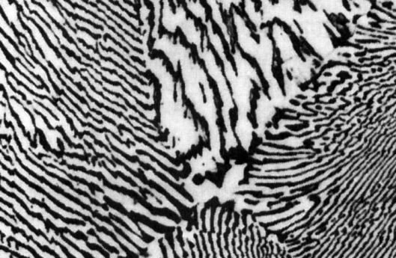
Microstructures in Eutectic Systems: III
• C_{o} = C_{E}
• Result: Eutectic microstructure (lamellar structure)
--alternating layers (lamellae) of α and β crystals.
T(°C)
Micrograph of Pb-Sn
eutectic
L: C_{o} wt% Sn
microstructure
300
L
Pb-Sn
system
L
+
α
α
β
200
183°C
L + β
T_{E}
100
α + β
160 μm
β: 97.8 wt% Sn
Adapted from Fig. 9.14, Callister 7e.
α: 18.3 wt%Sn
0
20
40
60
80
100
18.3
C_{E}
97.8
Adapted from Fig. 9.13, Callister 7e.
61.9
C, wt% Sn

Slide 23
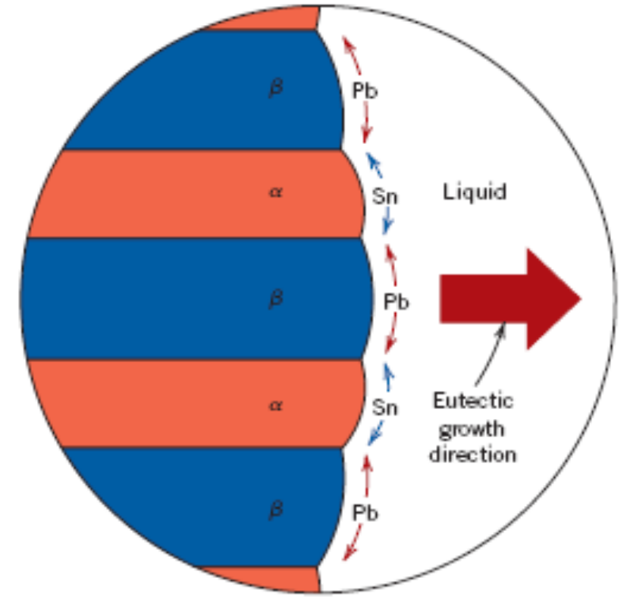
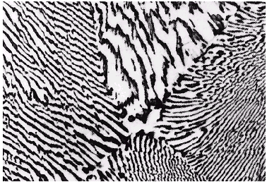
Lamellar Eutectic Structure
Adapted from Figs. 9.14 & 9.15, Callister 7e.

Slide 24
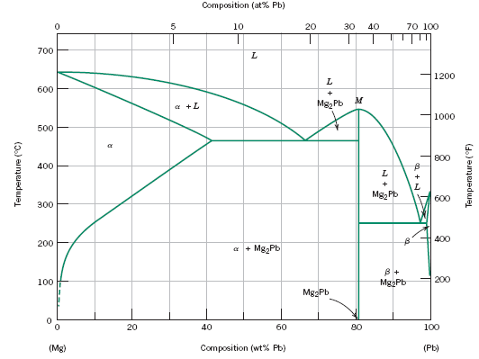
Intermetallic Compounds
Adapted from
Fig. 9.20, Callister 7e.
Mg₂Pb
Note: intermetallic compound forms a line - not an area - because stoichiometry (i.e. composition) is exact.

Slide 25
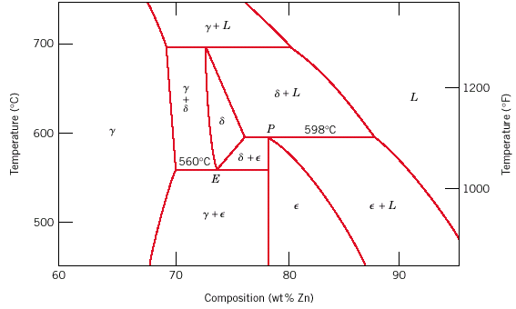
Eutectoid & Peritectic
Peritectic transition γ + L δ
Cu-Zn Phase diagram
Adapted from
Fig. 9.21, Callister 7e.
Eutectoid transition δ γ + ε

Slide 26
Summary
• Phase diagrams are useful tools to determine:
--the number and types of phases,
--the wt% of each phase,
--and the composition of each phase
for a given T and composition of the system.
• Alloying to produce a solid solution usually
--increases the tensile strength (TS)
--decreases the ductility.
• Binary eutectics and binary eutectoids allow for
a range of microstructures.

Slide 27
3)Thermodynamics of mixing
Why do some things mix and others not?
Why does heating promote mixing?
Is an alloy of two semiconductors a random solid solution, or is it just a mixture of two phases?
Solid solution
OR
Mixture of phases ?

Slide 28
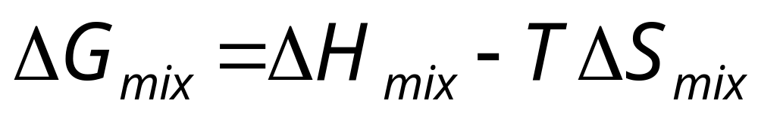
Free energy of mixing
Enthalpy term – bond energies
Entropy term – stats of mixing
→ behaviour of mixtures ☺
consider the case: Pure A + Pure B → mixture A_{x}B_{1-x}

Slide 29
Enthalpy term: Compare the energy in bonds (V_{AB} etc) before and after mixing
Heat of mixing | Binding energy in mixture compared to average in components | Binding energy change on mixing | ΔH_{mix}
Exothermic | V_{AB} > 1/2(V_{AA} + V_{BB}) | Stronger | -ve
Ideal | V_{AB} = 1/2(V_{AA} + V_{BB}) | Same | 0
endothermic | V_{AB} < 1/2(V_{AA} + V_{BB}) | Weaker | +ve

Slide 30
ΔH_{mix} derived
For reference only
ΔH_{mix} = (H for mixture AB) – (H for pure A + H for pure B)
ΔH_{mix} = zNx_{A} x_{B} {1/2(V_{AA} + V_{BB}) – V_{AB}}
N_{AA} etc = number of bonds of type AA, AB etc
N_{A}, N_{B}, number of atoms of A, B. N_{A} + N_{B} = N
V_{AA}, V_{BB}, V_{AB}, = binding energies of pairs A-A,
x_{A} etc = N_{A}/N = mole fraction of A
x_{B} = N_{B}/N = mole fraction of B.
x_{A} = (1-x_{B} )
z = co-ordination number

Slide 31
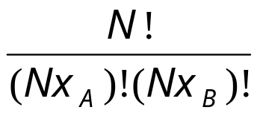
ΔS_{mix} derived
For reference only
ΔS = (S_{final} – S_{initial})
S_{final} from the statistical definition S = k_{B}lnw
ΔS_{mix} = k_{B}ln
Using Stirling’s approximation lnn! = nlnn-n gives
ΔS_{mix} = -Nk_{B}[ x_{A}lnx_{A} + x_{B}lnx_{B}]

Slide 32
ΔG_{mix} - the formula
For reference only
ΔG_{mix} = zNx_{A} x_{B} {1/2(V_{AA} + V_{BB}) – V_{AB}}
+ Nk_{B}T[ x_{A}lnx_{A} + x_{B}lnx_{B}]
Binding energy term {...} may be +ve or –ve
Entropy term [...] is negative

Slide 33
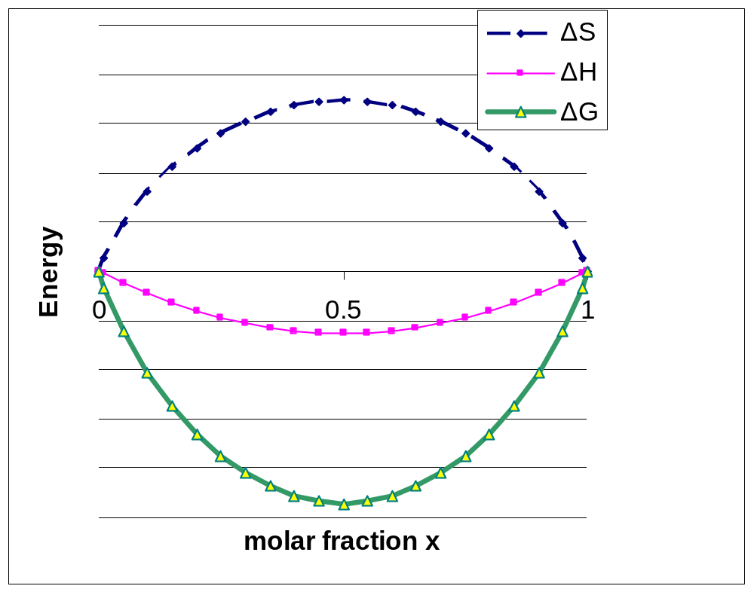
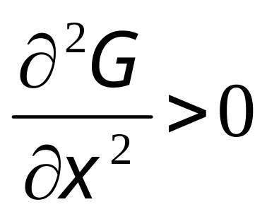
Examples – changing ΔH_{mix}
e.g. #1
T
i) Negative ΔH_{mix}
The free energy curve is concave downwards at all points at all x.
A mixes with B in all proportions.
for all x

Slide 34
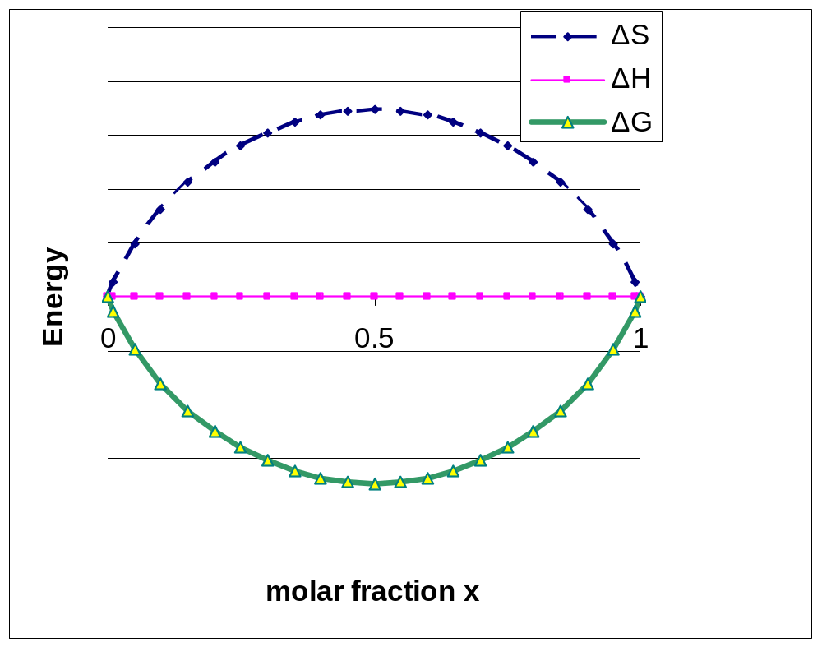
changing ΔH_{mix} e.g. #2
ii) ΔH_{mix} = 0
“ideal solution”
mixing is entropy driven.
miscibility over the whole composition range.
T

Slide 35
changing ΔH_{mix} e.g. #3
iv) ΔH_{mix} large and positive
Enthalpy dominates
miscibility gap exists
In gap, solid segregates into x_{A}’ and x_{A}’’
T
ΔS
ΔH
ΔG
Energy
0
0.5
1
x’
x’’
Miscibility
gap
x

Slide 36
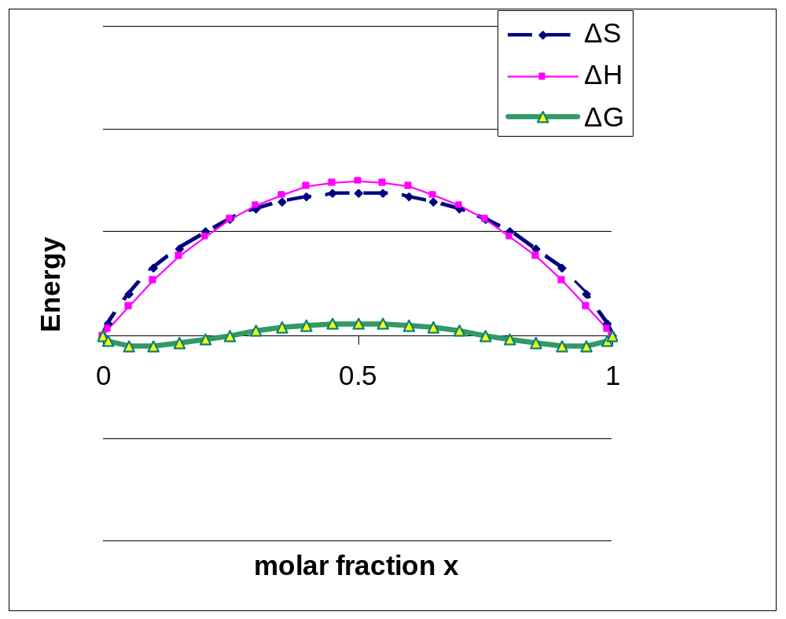
Low T
T

Slide 37
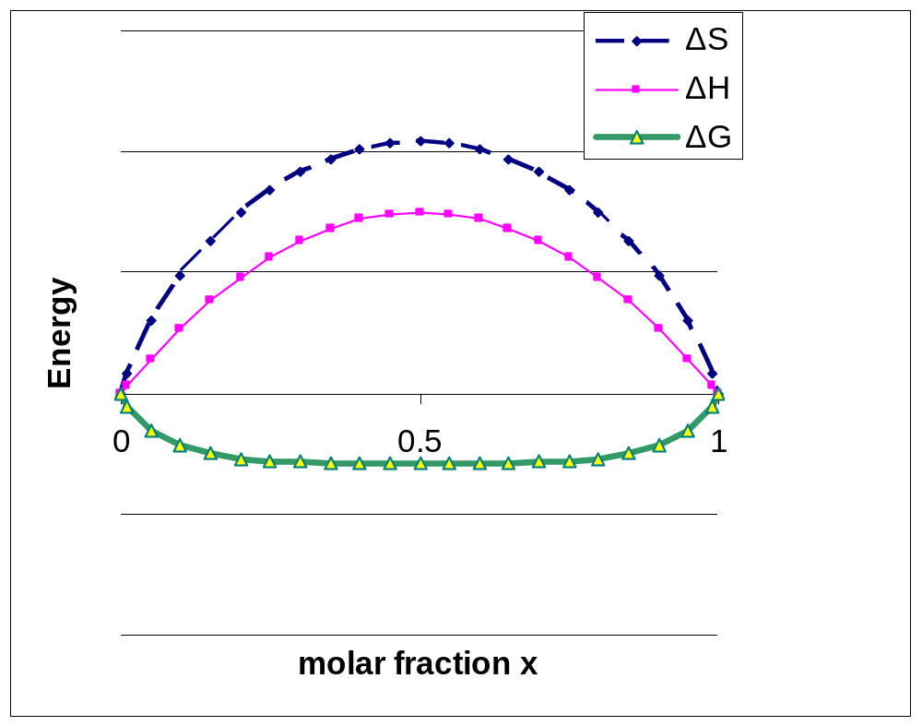
Moderate T
T

Slide 38
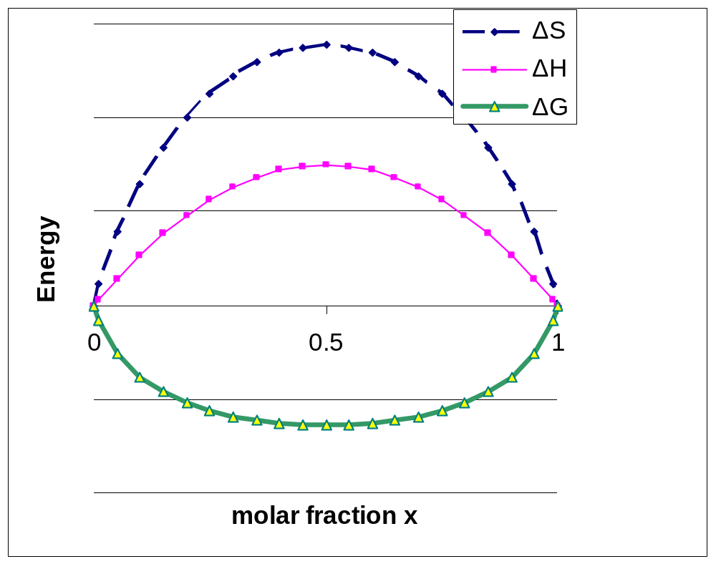
High T – mixing is promoted
T

Slide 39
Binary isomorphous phase diagram
L
L + solid
T
solid
Mole fraction x

Slide 40
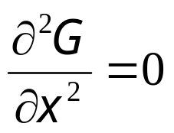
Phase diagram with miscibility gap
L
L + solid
T
B
solid
x’
x’’
locus
A
or ‘spinode’
Mole fraction x

Slide 41
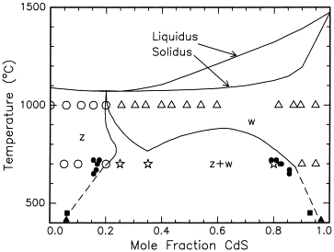
Example phase diagram
CdTe-CdS

Slide 42
Pb-Sn Eutectic System (2)
Worked example of earlier concept
• For a 40 wt% Sn-60 wt% Pb alloy at 200°C, find...
--the phases present:
α + L
Pb-Sn
system
T(°C)
--compositions of phases:
C_{O} = 40 wt% Sn
C_{α} = 17 wt% Sn
300
L (liquid)
C_{L} = 46 wt% Sn
L
+
α
--the relative amount
of each phase:
220
α
200
R
S
L
+
β
β
183°C
C_{L} - C_{O}
46 - 40
W
α
=
=
100
C_{L} - C_{α}
46 - 17
α
+
β
6
=
= 21 wt%
29
0
17
20
40
46
60
80
100
C_{O} - C_{α}
23
C_{α}
C_{o}
C_{L}
C, wt% Sn
W
L
=
=
= 79 wt%
Adapted from Fig. 9.8,
Callister 7e.
C_{L} - C_{α}
29

